Slide 1
Tropos field area networks
November 2013
for smart grid applications

Slide 2
Agenda
Tropos overview
Where we fit in the overall communications architecture
Key architectural choices/alternatives
Broadband vs narrowband
Public vs private
Licensed vs unlicensed
PTMP vs mesh
What the key challenges are:
Reliability, range, security, TCO
Discussion: Where technology is headed:
New spectrum: TVWS, 3.65 GHz, 700 MHz, 5GHz
New RAN technologies: LTE, 802.11ac, 802.15.4g, MIMO

Slide 3
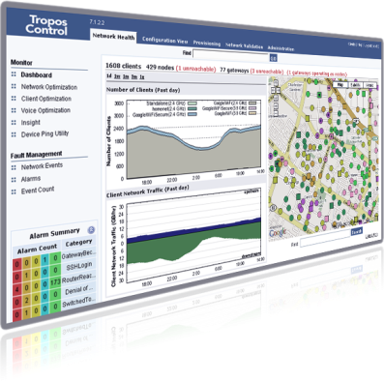
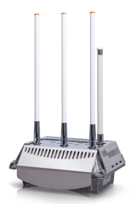
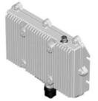
Tropos mesh network overview
Wireless IP networks for mission-critical applications
Founded 2000, acquired by ABB in 2012
Products: Mesh routers, directional radios, network management
Attributes: High capacity, low latency, reliable, secure, adaptable
Field-proven success:
Installed for 10+ years, acquired by ABB in 2012
850+ customers in 50+ countries
60,000+ installed routers
Customers: utilities, oil and gas, mining, public safety, military and industrial applications

Slide 4
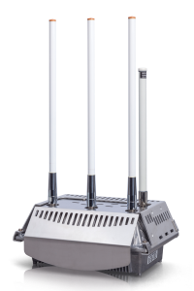
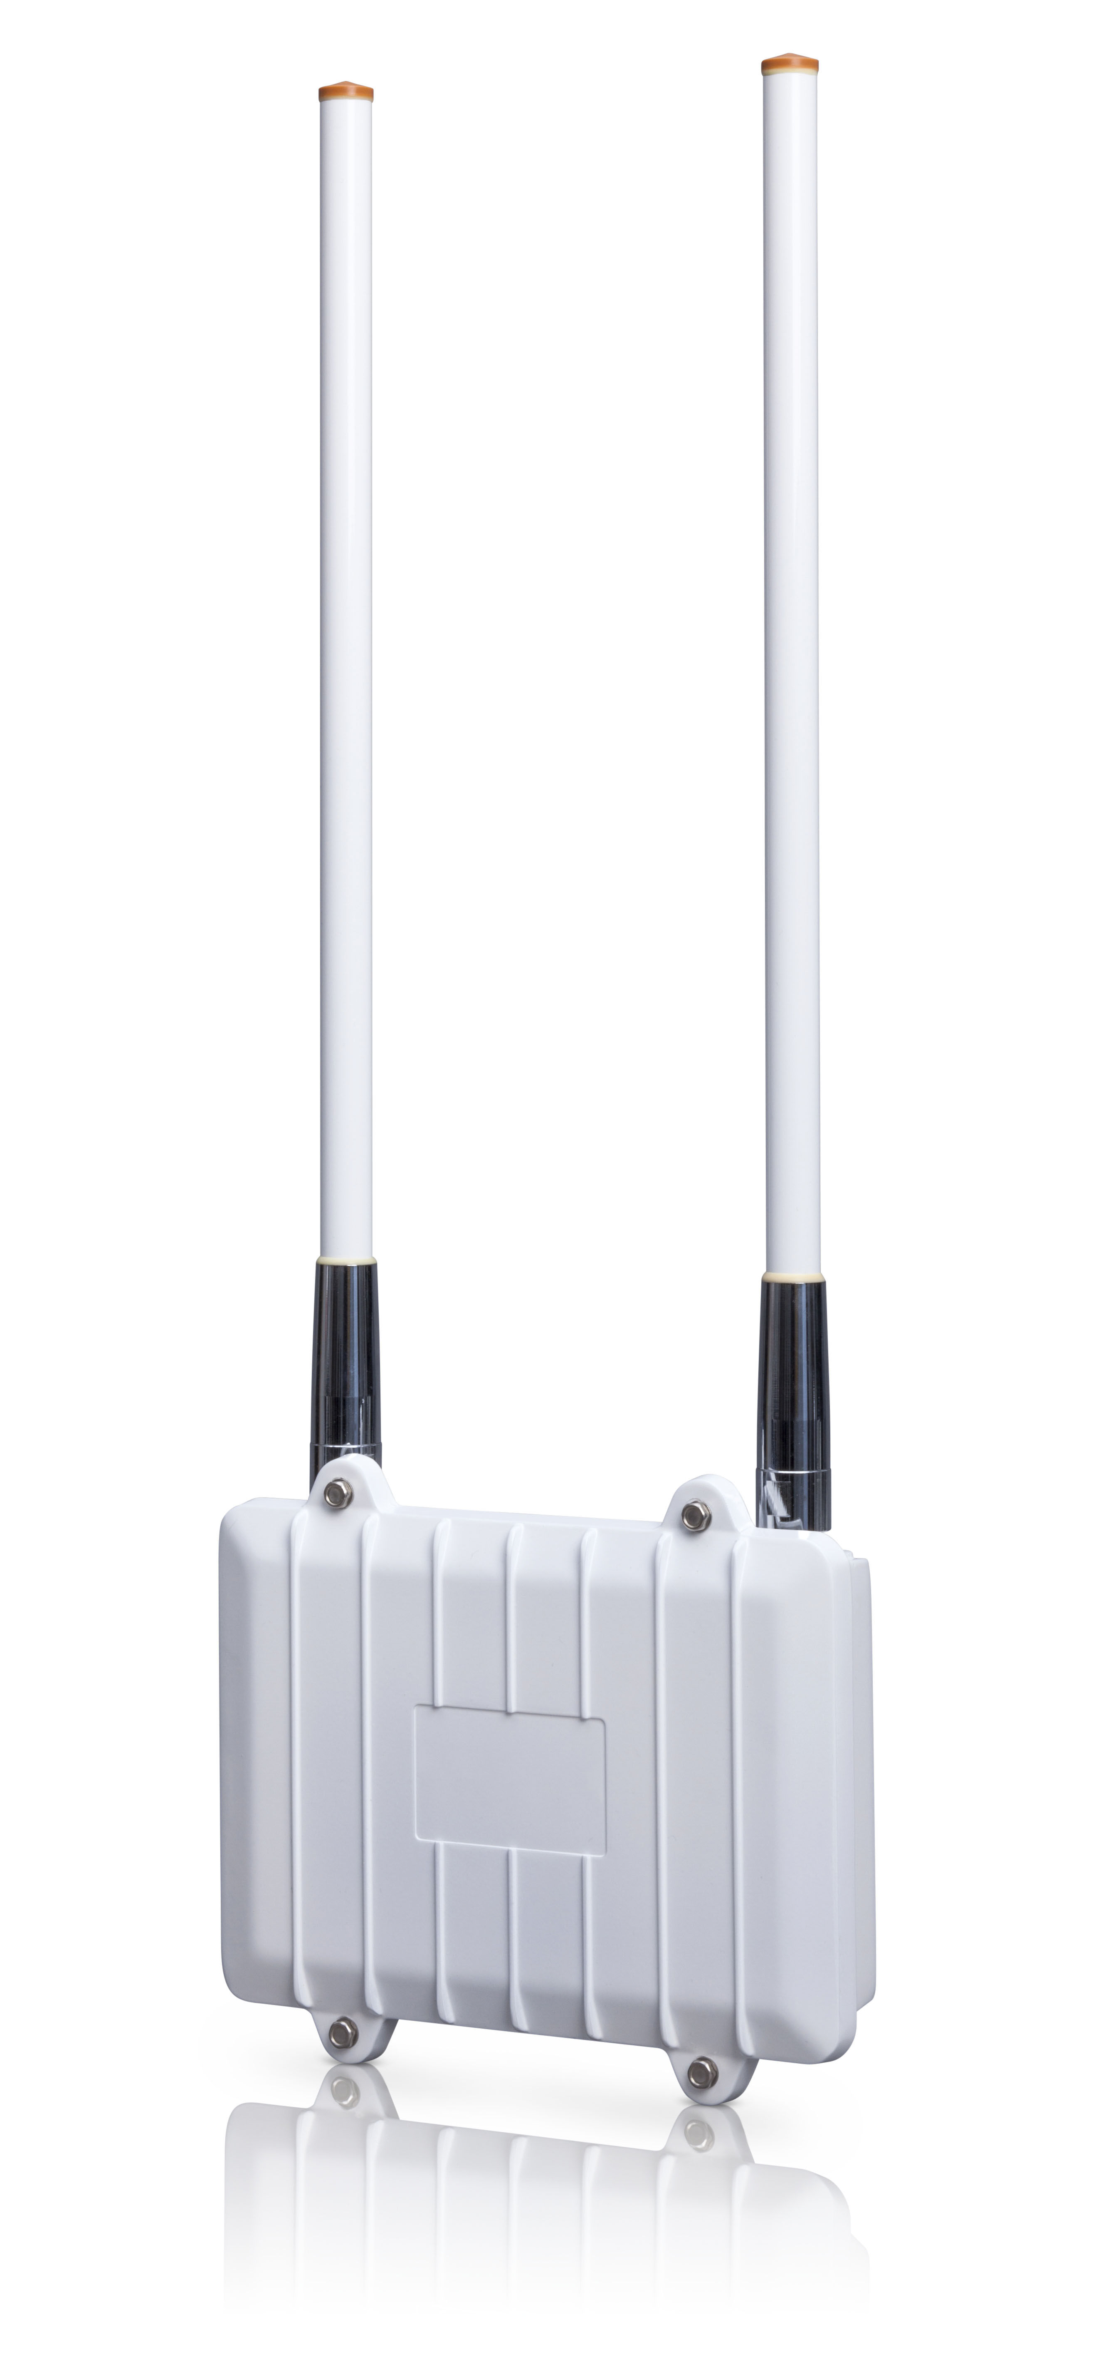
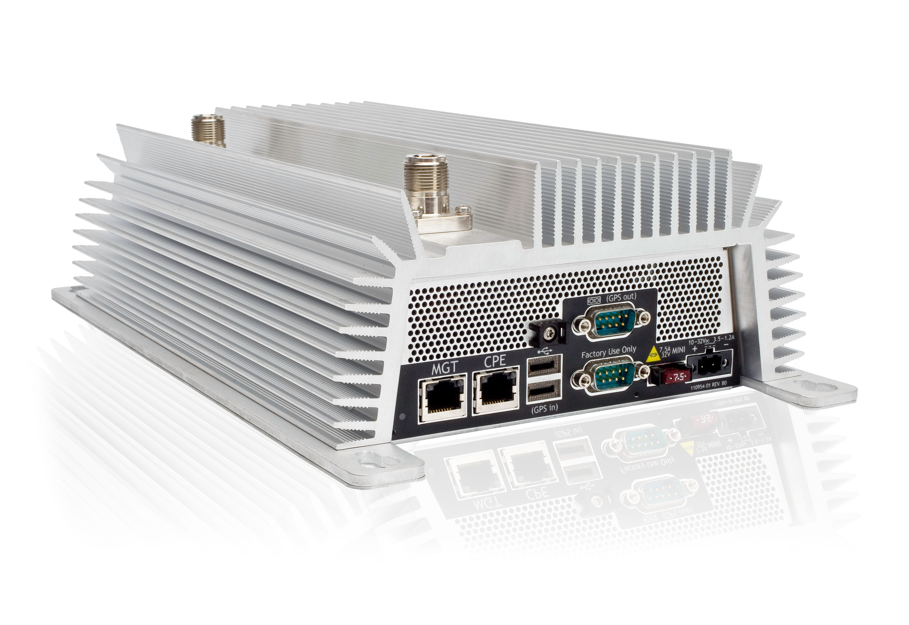
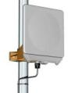
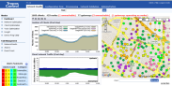
What Tropos provides
A cost-effective, standards-based wireless IP network communications system
Hardware, software, management and analysis tools
Ruggedized, weatherized equipment
Carrier-class management
Enterprise-class security
An enabler for a diverse set of applications
Hundreds of applications over one network
Provides capacity for future applications
IP-based applications ease rollout
Field automation, SCADA, security and surveillance, mobile workforce

Slide 5
Where Tropos fits
November 2013

Slide 6
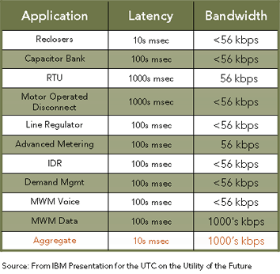
Applications Drive Bandwidth Requirements
Other high traffic applications
Substation Video
PHEV Station
Mobile GIS
AVL
…and more in the future

Slide 7
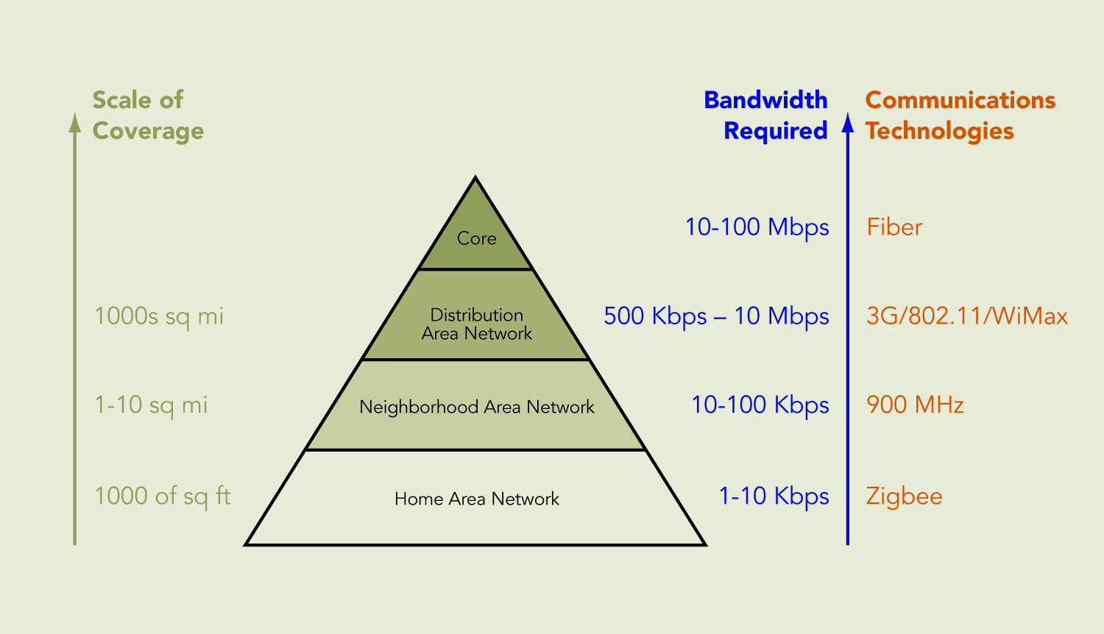
Higher tiers require more aggregate bandwidth
Same as enterprise networks

Slide 8
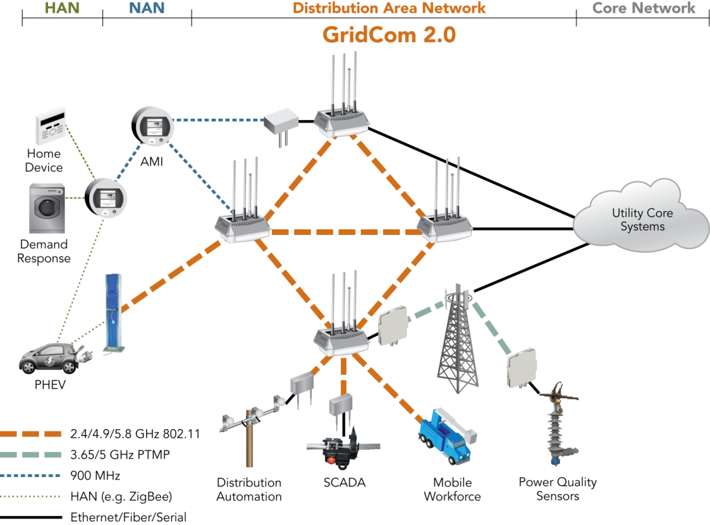
Tropos Distribution Area Network

Slide 9
Keys to successful field area networks
Standards-based
TCP/IP, 802.11, 802.3 Ethernet, 802.1x….
Legacy protocol support: serial links, DNP3…
High bandwidth & low latency
> 10 Mbps throughput at each node, < 1 ms latency per hop
Resilient
Self-organizing mesh, hardened equipment, can deliver > 99.999% system availability
Secure
Multi-layer/multi-application model, enterprise-class
Manageable
Scalable to economically cover small areas to thousands of square miles

Slide 10

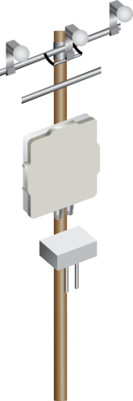
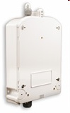
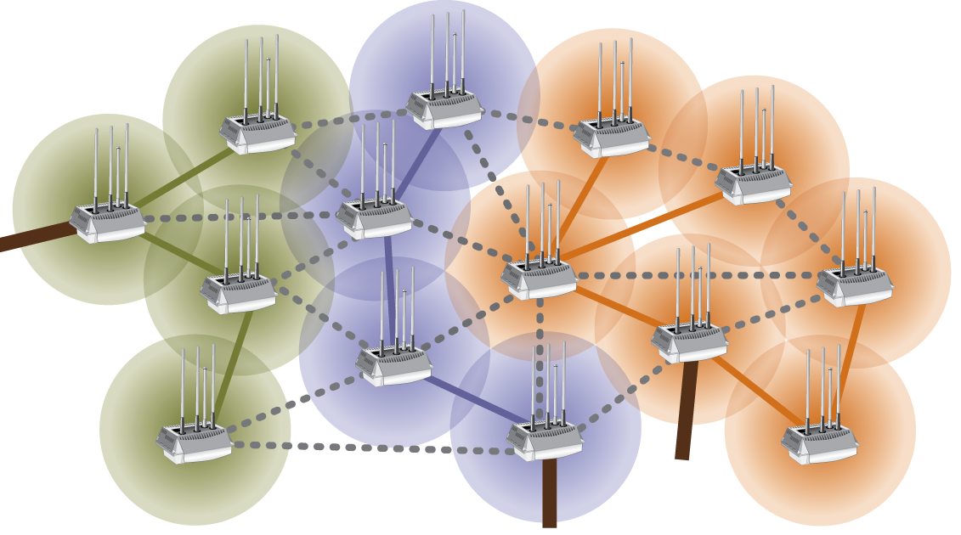

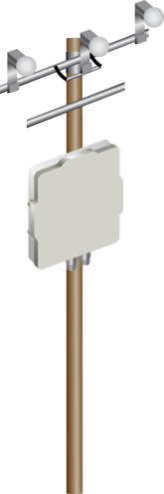
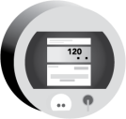
Competitive landscape
Five competitive smart grid communications architectures
Broadband PTP/PTMP
Narrowband PTP/PTMP
Broadband Mesh
Capacity
AMI Mesh
DA
Commercial cellular data services
Broadband mesh networks
Multi-application networks for DA, AMI backhaul, mobility
AMI metering networks
Low bandwidth, long latency networks, typically mesh
Broadband PTP/PTMP
Substation capacity, capacity injection into mesh networks (AMI and broadband), direct connectivity to DA devices
Narrowband PTP/PTMP
Low bandwidth, low latency, long range connectivity to sparse assets: AMI collectors, DA devices

Slide 11
Architectural choices: Narrowband vs Broadband
November 2013

Slide 12
Selecting a network communications strategy
Traditional approach
Network per project
Build/pay as you go
SCADA
Distribution automation
Telemetry
Field data applications,…
Strategic approach
Layered communications architecture
Supports for current plus future applications
Minimizes incremental spend for additional field applications
Leverages standards to make application roll out easier

Slide 13
Smart Networks fundamental to Smart Grid
Extended Utility Roles
Demand Response
Expected Value
Distribution Operations & Automation
AMI
Initial Capital Outlay
Meter functionality
Communications infrastructure
Head-end & legacy systems modifications
Incremental Capital Commitment
Source: AEP

Slide 14
Architectural choices: Mesh vs Cellular
November 2013

Slide 15
Cellular vs. private networks
Metric | Cellular | Private Network
Availability | Moderate-high availability | Can be designed to be very high availability (five nines)
Survivability | OK for non-critical data transport, inadequate for mission-critical apps | Highly survivable architectures and technology options
Coverage | Limited coverage in rural/lightly-populated areas | Can be engineered to very high levels, but requires mix of technologies
Latency | 100-1000 ms | 10-100 ms
Security | Adequate | Highly secure options exist

Slide 16
In many situations, private is strongly preferred
Coverage: Environments that have to build private networks because of lack of cellular coverage
Remote locations (mines, ships, oil rigs, rural area), indoors (industrial)
Performance: Where application performance needs can not be met by public cellular network
Demanding applications: low latency DA (reclosers, sectionalizers, automated feeder reconfig)
Mission-critical apps that require QoS and prioritized access
Cost: Where private offers a less expensive solution
Rate structure favors capital spend over Opex
Public cellular data pricing is high and/or unpredictable
Large number of devices and/or apps makes private cheaper
Other: Other segments which prefer private to public when both are viable options
In substation or industrial setting where 802.11 exists
Customer desires complete control with no dependence on public infrastructure

Slide 17
Public vs. private networks
Summary
Competing approaches, but can also be complementary to a great extent. For example:
Private mesh networks can extend the coverage of cellular and fill in dead spots
Communications nodes can leverage multiple uplinks for failover
Utilities are continuing to use public networks for
Non-mission-critical applications (AMI backhaul, …)
Point applications
Fill-in for coverage where it may not be economical to build private networks
Utilities tend to prefer private networks, especially where
Mission-critical apps have stringent performance and reliability requirements
Network is viewed as a common foundation for multiple smart grid applications
Notes:
Cellular is a good fit for certain applications and use cases - for example AMI backhaul. It is less of a fit for mission-critical apps that need high reliability and high performance. Utilities have used cellular in their comms networks and will probably continue to do so.
Private network technologies offer much higher levels of reliability and performance and offer utilities a lot more control. Much better fit for mission-critical apps. Also, makes more economic sense when the network is viewed not just as a solution to a tactical problem of transporting data for a specific application, but rather as the strategic asset underpinning multiple applications that the utility will deploy over the next 15-20 years.

Slide 18
Architectural choices: Licensed vs Unlicensed
November 2013

Slide 19
Comparing licensed and unlicensed spectrum
 | Exclusively Licensed Spectrum | Lightly Licensed Spectrum | Unlicensed Spectrum
Cost
Availability
Performance
Interference
Security
Interoperability
Poor
Best

Slide 20
Architectural choices: Broadband mesh vs AMI mesh
September 2012

Slide 21
Bandwidth and latency
Requirements vs. performance
Broadband Mesh Performance
Video
Mobile
WF
Mbps
AMI
BH
AMI Mesh Performance
Throughput / device
Kbps
Protect
Volt VAR
Cont
Res
DR
AMI
bps
1 msec
100 msec
1 sec
>5 sec
Latency

Slide 22
Architectural choices: Mesh vs Broadband PTMP
November 2013

Slide 23
Mesh architectures and applications
Mesh architectural attributes:
Self-organizing → military ad hoc networks
Resilient and self-optimizing → High-reliability mission-critical communications in private networks
High capacity → densified small cells (WiFi or LTE) for scaling mobile data capacity
Fractional backhaul → cost-effective solution where supporting wired infrastructure is minimal/expensive

Slide 24
Redundant paths, channels and bands
Tropos Mesh OS leverages multiple paths, channels and bands to create robust, high performance networks
Mesh links dynamically choose 5 GHz or 2.4 GHz band
Channel within band automatically chosen on a per link basis
MESH NODE
MESH NODE
MESH NODE
MESH NODE
MESH NODE
MESH NODE
MESH NODE
MESH NODE
MESH NODE
MESH NODE
MESH NODE
MESH NODE
MESH NODE
MESH NODE
Wired backhaul
2.4 GHz Link
5.X GHz Link
Optimal routing paths
Backup links
Notes:
24

Slide 25
PTMP and Mesh are Complementary
Pont-to-multipoint (PTMP) and Mesh are complementary technologies for the DAN layer
PTMP is very cost-effective for suburban and rural deployments and for mesh capacity injection in denser areas
Mesh is well-suited for urban areas providing resilience and higher capacity
Optimal combination of Mesh and PTMP leverages the strengths of both
Mesh extends coverage range of PTMP and improves reliability
Architectural resilience through mesh failover capabilities
Combined deployment achieves
Economics optimized for mix of urban/suburban/rural areas
Meets requirements for multiple DAN applications

Slide 26
GridCom Architecture: Mesh + PTMP
Expand PTMP Cell Radius
With Combination of PTMP + Tropos
Increase System Availability (>99.99%)
With Tropos Mesh Routing Technology
Reduce #
of Towers
5
10+
5 mile radius → 10+ mi radius
78.5 sq miles → 300 to 1,000+ sq miles
3 to 10 x coverage per tower
Eliminate PTMP Shadowing (Route around obstacles)

Slide 27
What Mix of Mesh and PTMP Looks Like
Data Center(s)
Tropos
Control
Tier 1 / Tier 2
Fiber
Microwave
Spur
Tropos Gateway (GW)
Routers Installed at
Tier 1 Core Sites
Tier 1: Fiber (SONET, GigE), Microwave, MPLS Core
Tier 1 Topology Implemented with
Path Diversity Where Possible
Tropos Node (ND) Routers
Distribute Tier 2
Capacity Across
Urban/Suburban
Service Areas
GW
GW
GW
Smart Grid Devices
Connect via Wired
or Wireless Ethernet
to Tropos Mesh Nodes
Rural Subscribers
Served via P2MP
Mesh Used in Rural
to Overcome P2MP
Propagation Obstacles
P2MP Demarc to
Mesh Gateways
Decreasing Mesh Density
Transition to WiMAX/P2MP/LTE
Tier 3 (NAN)
Dense
Urban
Urban
Suburban
Rural / Ultra Rural
Tier 4 (HAN)

Slide 28
Summary
November 2013

Slide 29
Keys to successful field area networks
Standards-based
TCP/IP, 802.11, 802.3 Ethernet, 802.1x….
Legacy protocol support: serial links, DNP3…
High bandwidth & low latency
> 10 Mbps throughput at each node, < 1 ms latency per hop
Resilient
Self-organizing mesh, hardened equipment, can deliver > 99.999% system availability
Secure
Multi-layer/multi-application model, enterprise-class
Manageable
Scalable to economically cover small areas to thousands of square miles

Slide 30
Where technology is headed
November 2013

Slide 31
Field automation communication challenges
Communicate with thousands of endpoints in large geographic areas
Reliability of connections
Network capacity headroom to enable future applications
Low latency to support automation applications
Support multiple applications with QoS, security and traffic segmentation
Scalable to large number of devices covering large geographic areas
Cost-effective
Easy interoperability with edge devices, avoid stranded assets

Slide 32
Research Themes
Interference mitigation
Longer range
System cost
Cybersecurity
Heterogeneous networks
Ease of installation and management
Smaller footprint endpoints (lower power consumption, lightweight routing stack, lower cost radios)
Heavily loaded networks

Slide 33
Tropos field area networks
November 2013
for smart grid applications

